Slide 1


PREVENTION OF CRUELTY TO ANIMAL ACT
A SEMINAR SUBMITTED TO ANDHRA UNIVERSITY IN THE PARTIAL FULFILMENT FOR THE AWARD OF THE DEGREE OF MASTER OF PHARMACY
in PHARMACEUTICAL REGULATORY AFFAIRS Presented by SWAMY
(Reg.no 621275227011) Under the guidance of Y. SAI PHANINDHRA, M. pharm, Ph. D., Professor
K.G.R.L COLLEGE OF PHARMACY (Under the Management of The Bhimavaram Education Society) Affiliated to Andhra University, Approved by PCI (New Delhi)SBTET and APSCHE (Amaravati)

Slide 2
contents
Introduction
Objectives & Definitions
Committee for the purpose of control & supervision of experiments on Animals
Duties & power of the committee
Objectives of the rules by committee
Institution Animals ethics committee
Constitution of IAEC
Cruelty to Animals
Offences and Penalties
Surveillance diagnosis treatment & control disease
Anaesthesia & methods

Slide 3
Introduction
This Act may be called the prevention of cruelty to Animals Act 1960.
It extends to the whole of India except the state of jammu and Kashmir.
It shall come into force on such date as the central government may, by notification in the official gazette, appoint, and difference dates may be appointed for different states and for the different provisions companied in this Act.
Nearly all developing countries have laws to save animals from cruelty, i.e., unnecessary pain and sufferings. It can also be said that these laws have been made to prevent humans from behaving cruelly towards the animals. In India, certain rules for this purpose were applied to various parts however most of them remained ineffective.

Slide 4
Laws for animals
Cruelty-wildlife-control
The constitution of India
The Indian Penal Code, 1860
The Criminal Procedure Code, 1973
The Prevention of cruelty to Animals Act, 1960
The Wildlife Protection Act, 1972
The Police Acts
The Municipal Corporation Acts.

Slide 5
Objectives and Definitions
Objective
To prevent the infliction of unnecessary pain or suffering on animals as well as to prevent cruelty to animals.
Definitions
Animal means any living creature other than a human being.
“captive animal” means any animal (not being a domestic animal)which is in capacity or confinement, whether permanent or temporary, or which is subjected to any appliance of contrivance for the purpose of hindering or preventing its escape from captivity or confinement or which is pinioned or which is or appears to be maimed.

Slide 6
“Domestic animal” means any animal which is tamed or which has been or being sufficiently tamed to serve some purpose for the use of human or which although it neither has been nor is intended to be so tamed, is or has become in fact wholly or partly tamed.
“local authority” means a municipal committee, district board or other authority for the time being invested by law with the control and administration of any matters within a specified local area;
“owner” used with reference to an animal, includes not only the owner but also any other person for the time being in possession or custody of the animal, whether with or without the consent of the owner;

Slide 7
“phooka” or “doom dev” includes any process of introducing air or any substance into the female organ of a milch animal with the object of drawing off from the animal any secretion of milk;
“prescribed” means prescribed by rules made under this Act;
“Street” includes any way, road lane, square, court, alley, passage or open space, whether a thoroughfare or not, to which the public have access.
“cruelty” infliction of unnecessary pain or suffering.

Slide 8
Experimentation of Animals
Advancement by new discovery of physiological knowledge or
Knowledge which will be useful for saving or
For prolonging life or
Alleviate suffering or
For combating any disease, whether of human beings, animals or plants.

Slide 9
Committee for the purpose of control and supervision of experiments on Animals (CPCSEA)
Constituted by central government
CG nominates one of the member as chairman
Committee has power to regulate its own procedure
CG gives grants and funds to CPCSEA
Subcommittee can be formed to execute various functions
Committee may appoint staff members, officers and other employee
Duties and powers of the committee
The registration of the persons or institutions carrying on experiments on animals is essential;
The reports and other information which shall be forwarded to the committee by persons and institutions carrying on experiments or animals

Slide 10
Objectives of the rules made by CPCSEA
In particular and without prejudice to the generality of the foregoing power, rules made by the committee shall be designed to secure the following objects, namely
In cases where experiments are performed in any institution, the responsibility therefore is placed on the person in charge of the institution. In case where experiments are performed outside an institution by individuals responsibility therefore is placed on the person. The individual person must be technically qualified and competent.
Experiments should be performed with due care and humanity and that as far as possible experiments involving operations are performed under the influence of some anaesthetic of sufficient power to prevent the animal feeling pain.

Slide 11
That experiments on animals are avoided wherever is possible to do so; as for example; in medical schools, hospitals, colleges etc. if other teaching devices such as books, models, films may equally suffice.
That experiments on larger animals are avoided when it is possible to achieve the same results by experiments upon small laboratory animals like guinea-pigs, rabbits, frogs and rats.
As far as possible, experiments are not performed merely for the purpose of acquiring manual skill.
Animal intended for the performance of experiments are properly looked after both before and after experiments.
Suitable records are maintained with respect to experiments performed on animals

Slide 12
Institutional Animal Ethics Committee
Functions
To review and approve research proposals involving lab animals
To provide suggestions for modification of the proposals wherever necessary
To conduct periodic supervision of institute’s animal facility
To ascertain ethical use of animals and protection of well being of animals during and after research. When research activity is not found in accordance to CPCSEA guidelines to help adopt correct measures.
To see that all those persons involved in animal care and research as adequately trained to handle the animals.
To ensure GLP guidelines are followed in animal facility to protect the researchers and all other involved in animal handling

Slide 13
Constitution of IAEC
Biological scientist, chairperson
Scientist In charge of a Animal House Facility-Member Secretary
Scientist from different discipline (from different institute and from same institute)
Veterinarian
CPCSEA Main Nominee
Link nominee
The IAEC is valid for a period of five years and is renewed after that period
Any changes in IAEC members can be made only with prior approval of CPCSEA
IAEC is required to be reconstituted at the time of renewal of registration as per CPCSEA guidelines

Slide 14
It required to convene the meeting of the reconstituted IAEC within a period of 30 days and upload the same on the website of the CPCSEA
Only above approved IAEC members shall sign, with date , on the attendance sheet of the IAEC meetings, and decisions will be taken only in meetings where quorum is complete
The quorum for holding IAEC meeting is six (6) and CPCSEA nominees must be present in such meeting

Slide 15
Cruelty to Animals
Treating animals cruelty If any person
Beats, kicks, over-rides, over-drives, over-loads, tortures or otherwise treats any animals so as to subject it to unnecessary pain or suffering; or
Wilfully and unreasonably administers any injurious drug or injurious substance to (any animal) or wilfully and unreasonably causes or attempts to cause any such drug or substance to be taken by (any animal;)
Conveys or carries, whether in or upon any vehicle or not, any animal in such a manner or position as to subject it to unnecessary pain or suffering; or
Keeps or confines any animal in any cage or other receptacle which does not measure sufficiently in height, length and breadth to permit the animal a reasonable opportunity for movement; or

Slide 16
Keeps for an unreasonable time any animal chained; or
Being the owner, neglects to exercise or cause to be exercised reasonably any dog habitually chained up kept in close confinement; or
Without reasonable cause, abandons any animal in circumstances which tender it likely that it will suffer pain by reason of starvation thirst; or
Wilfully permits any animal, of which he is the owner, to go at large in any street, while the animal is affected with contagious or infectious disease or, without reasonable excuse permits any diseased or disabled animal, of which he is the owner, to die in any street; or
Offer s for sale or without reasonable cause, has in his possession any animal which is suffering pain by reason of mutilation, starvation, thirst, overcrowding other ill treatment; or

Slide 17
Offences and penalties
Treating animals cruelly is punishable with fine NLT Rs. 10/- which may extend to Rs. 50/- on first conviction. On subsequent conviction with in three year of previous offence, it is punishable with fine NLT RS. 25/- which may extend to Rs.100/- or imprisonment of three months or with both
Performing operation like phooka or any other operation to improve lactation which injurious to health of animal is punishable with fine up to Rs. 1000/- or imprisonment up to 2year or with both. Animal may be forfeited by the government.
Contravention of any order made by the committee or breach of any condition imposed by the committee is punishable with fine up to Rs.200/-

Slide 18
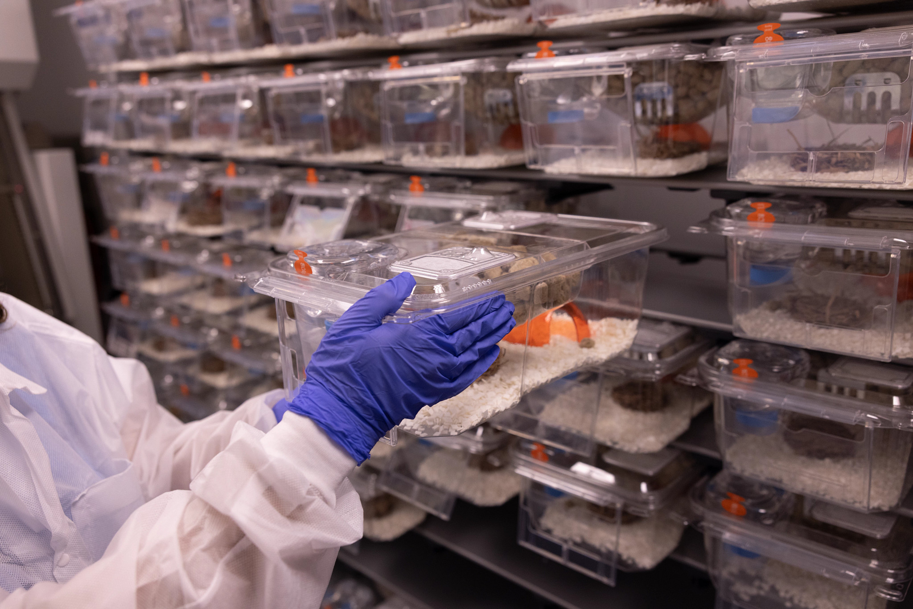
Surveillance, Diagnosis, Treatment And Control Disease
All animals should observed for signs of illness, injury, or abnormal behaviour by animal house staff.
Animals that show signs of a contagious disease should be isolated from healthy animals in the colony.
Animal care staff maintain a high standard of personal cleanliness.

Slide 19
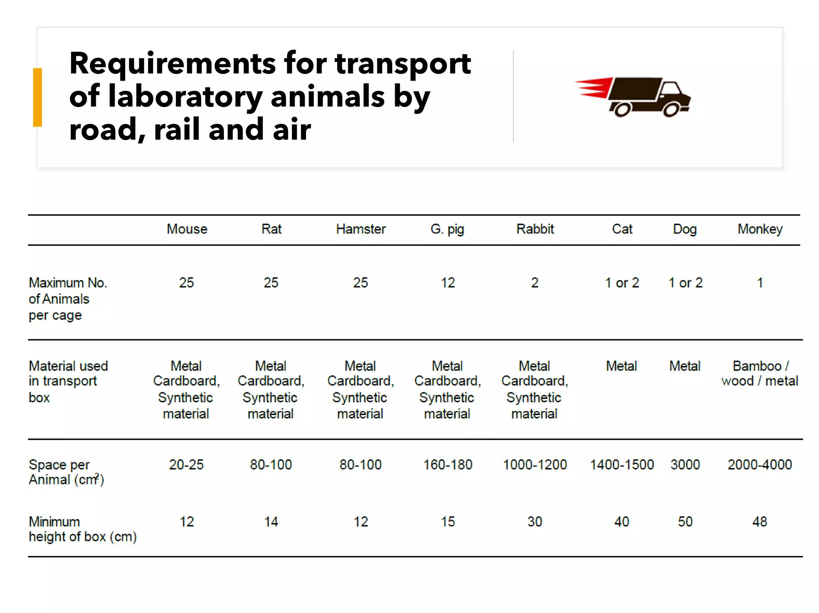

Slide 20
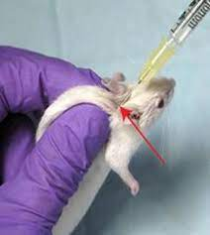
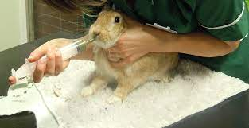
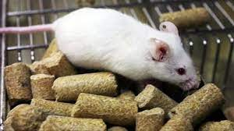
Anaesthesia & Method
Euthanasia (eu=good Thanatos=death)
Purpose: End of experiment, to provide tissue for scientific purpose.
Free the animal of pain, Diseased animal or animal in bad condition.
Method
Physical methods: electrocution, cervical dislocation
Drug administration: overdose of chloral hydrate, ketamine, chloroform

Slide 21


